Slide 1
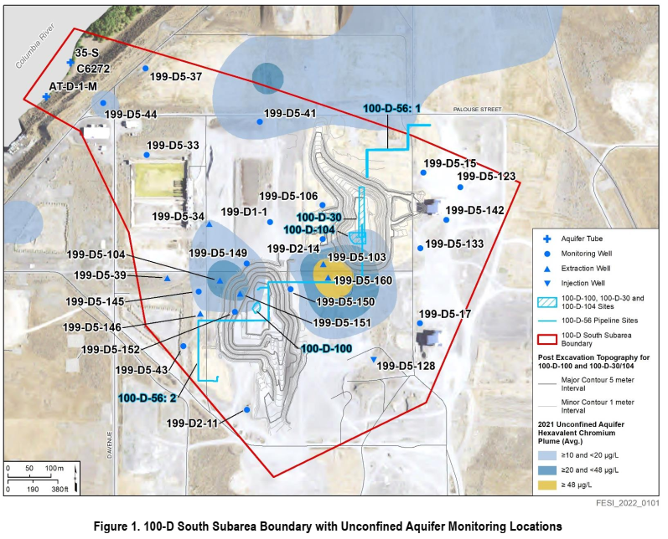
Well Groups:
NW of Sources
100-D-56
100-D-100
East of 100-D-56
West of 100-D-100
South of Sources

Slide 2
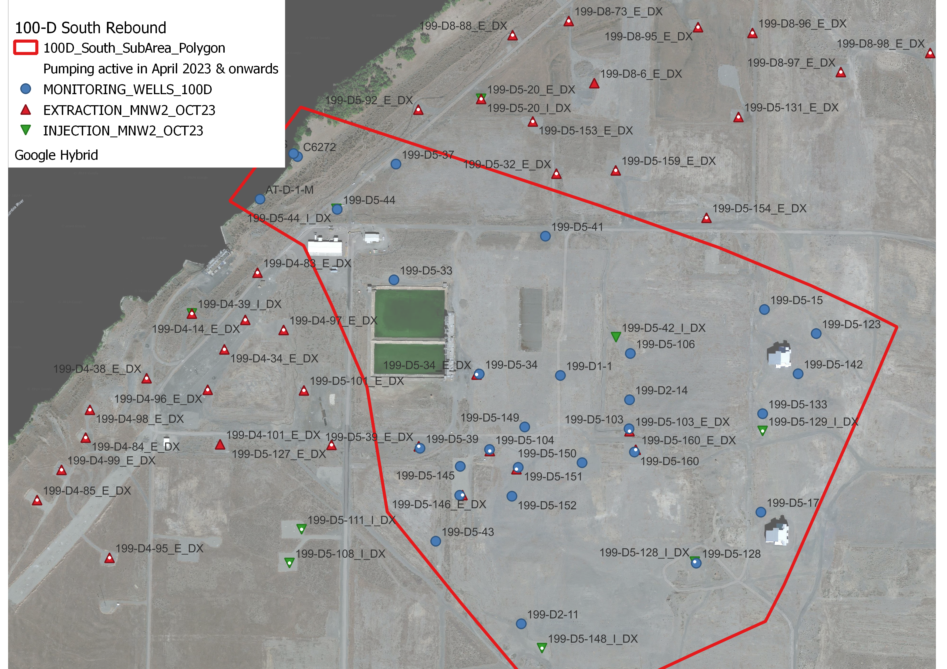
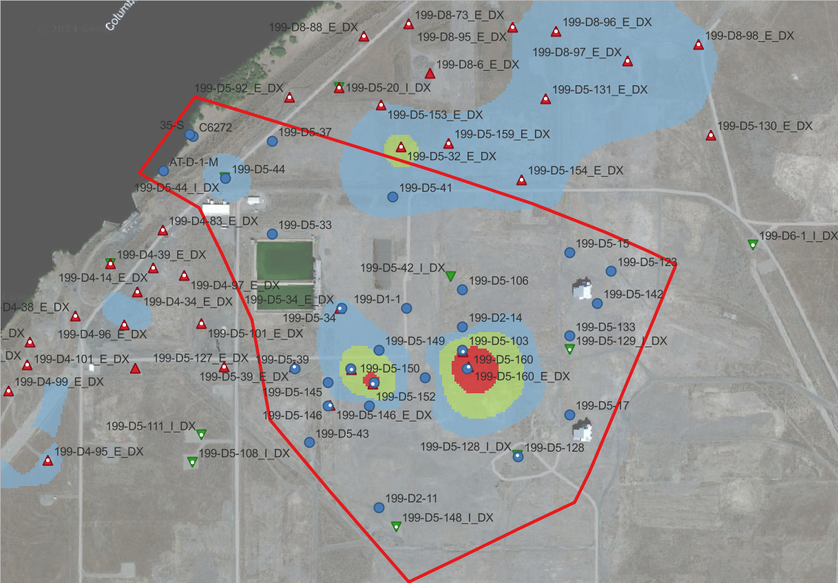
Northern extraction wells are active during rebound.
Mapped Plume from 2021

Slide 3
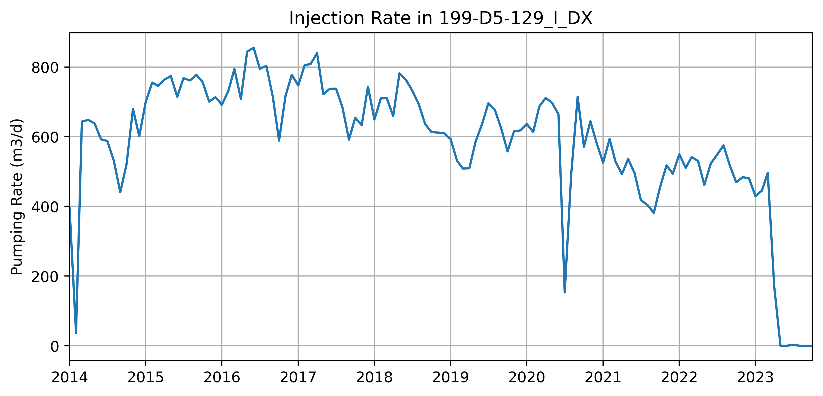
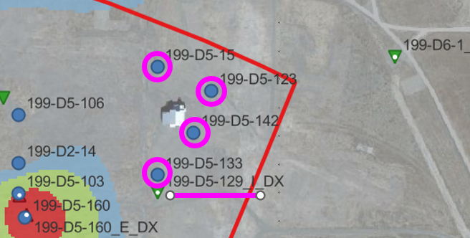
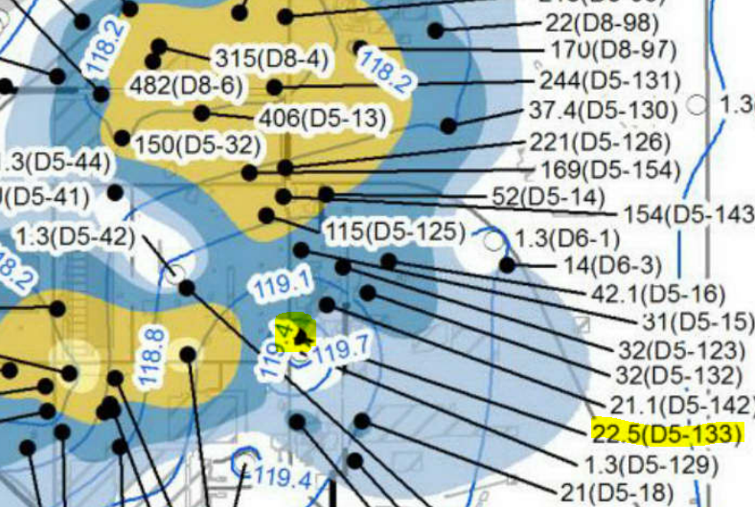
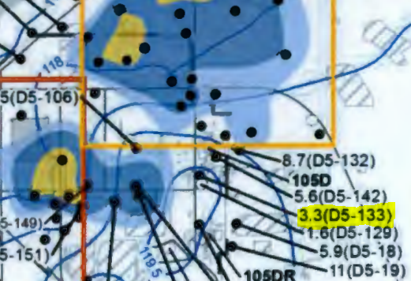
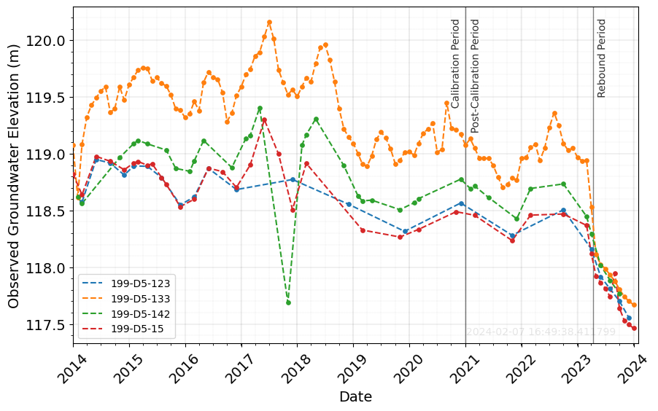
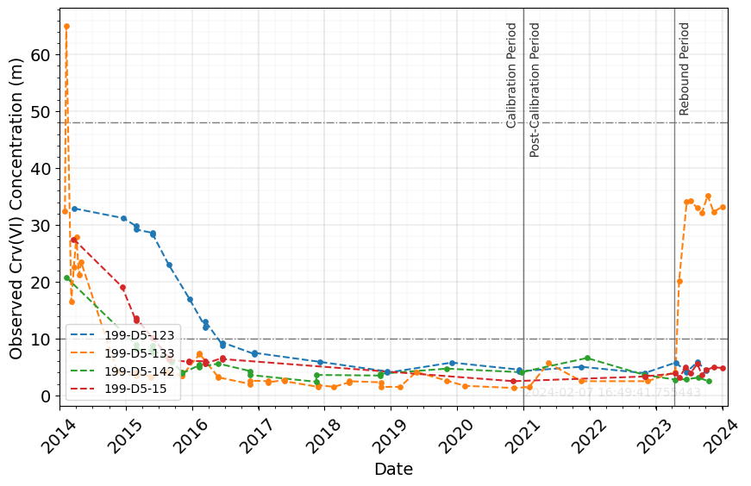
EAST OF 100-D-100
Mapped Plume 2014
Mapped Plume 2016
Offline in 4/23
D5-133: Cr increases during rebound period, significant WL decrease observed.
D5-129 was a strong injection well since 2014, went from 500 gpm to 0 during rebound. Closest to D5-133.
How is plume moving east? Or missing another source.

Slide 4
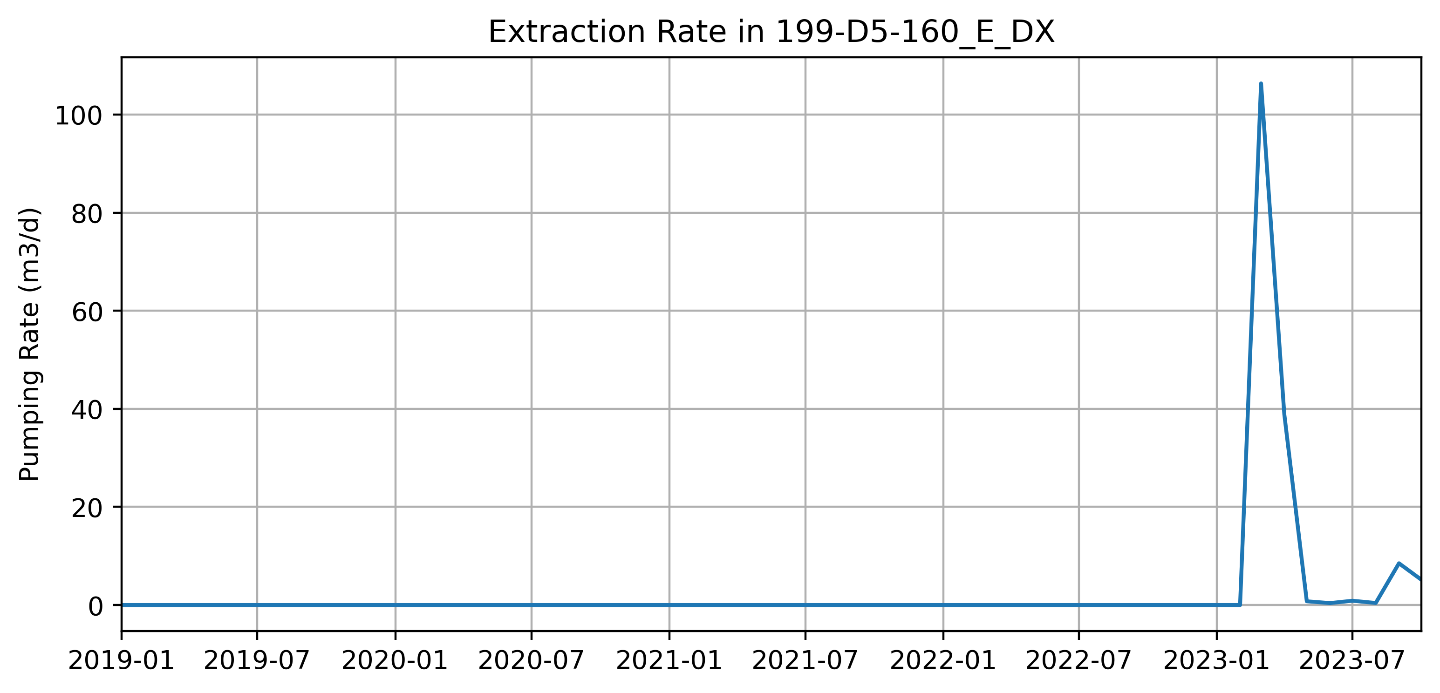
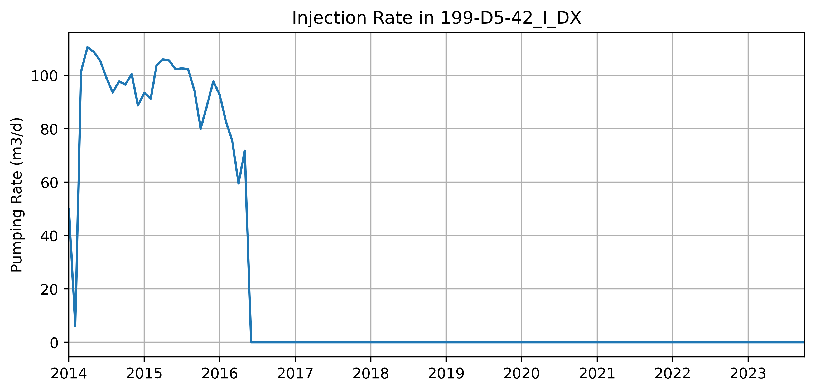
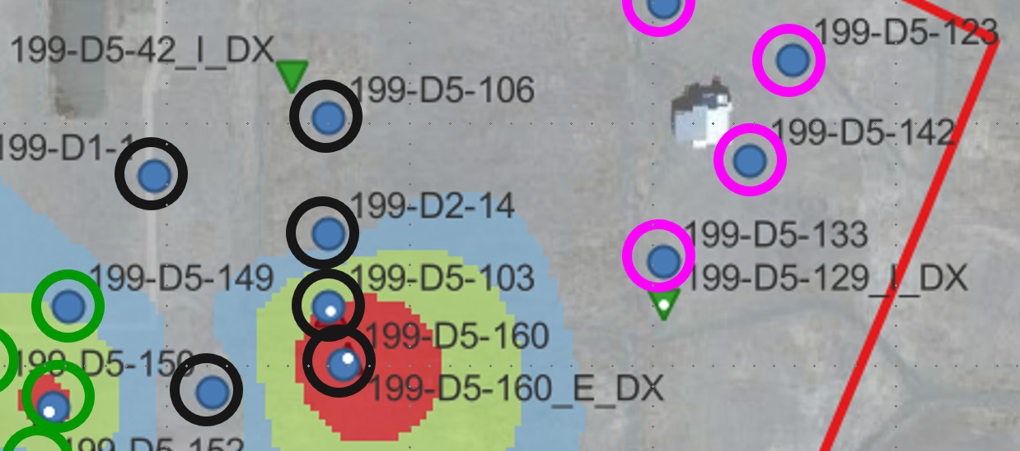
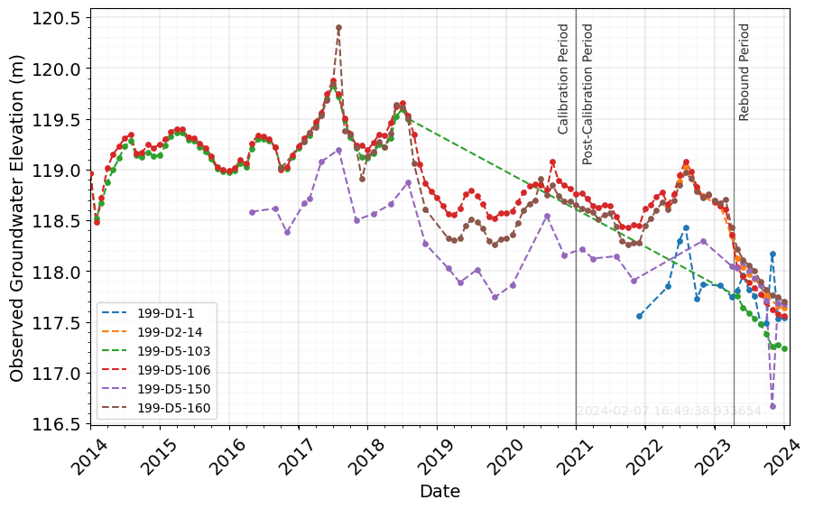
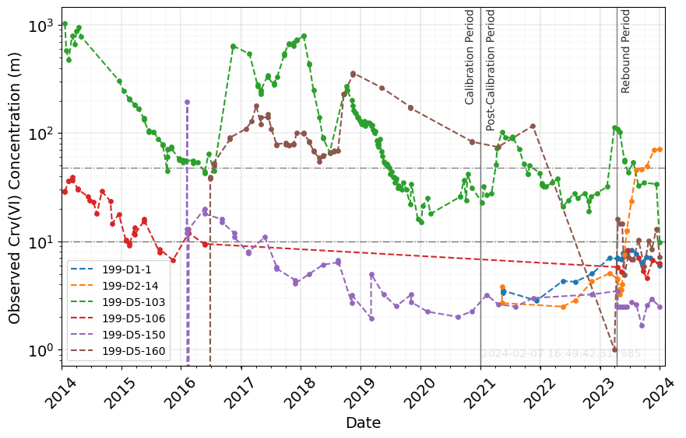
100-D-100
D5-160 Online in SP 3/23 and 4/23
D5-42 Offline in SP 30
(2016)
D2-14: Cr increases during rebound period, significant WL decrease observed.
D2-14 is located N-NW of 100-D-100.
D5-129 was a strong injection well, went from 500 gpm to 0 during rebound (D5-42 was already offline).
D5-160 and D5-103: Spikes (not increases) at start of rebound observed (Ext D5-160 ON in SP 111 and 112)

Slide 5
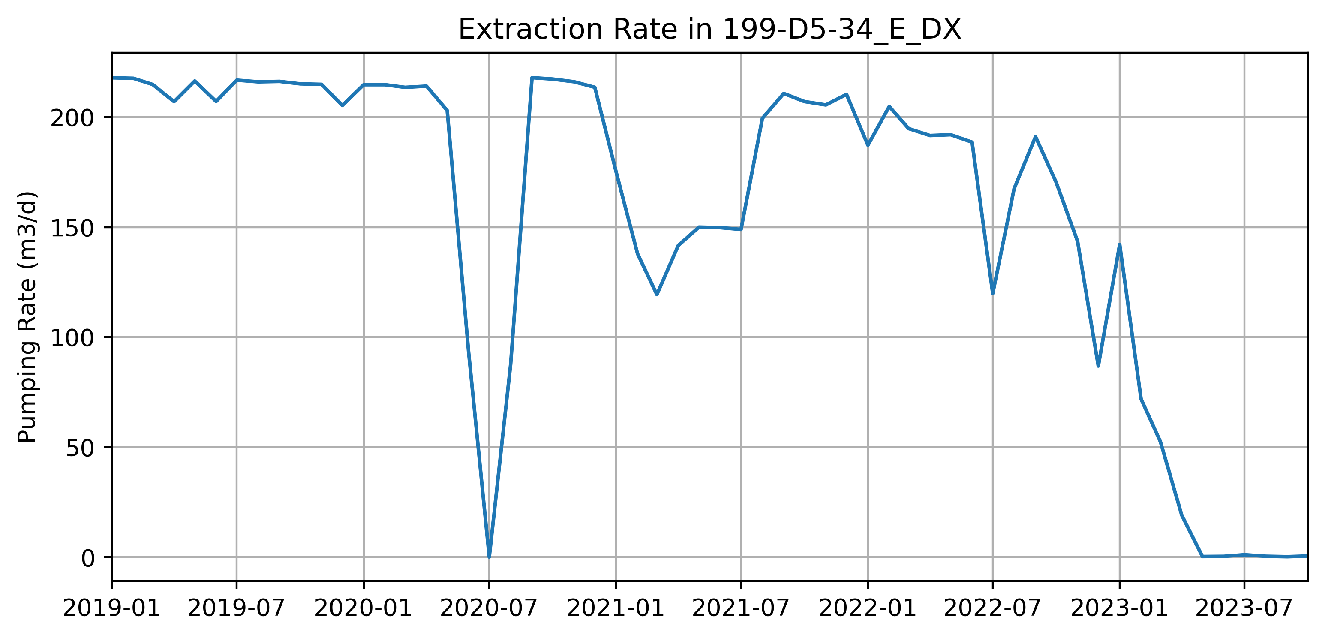
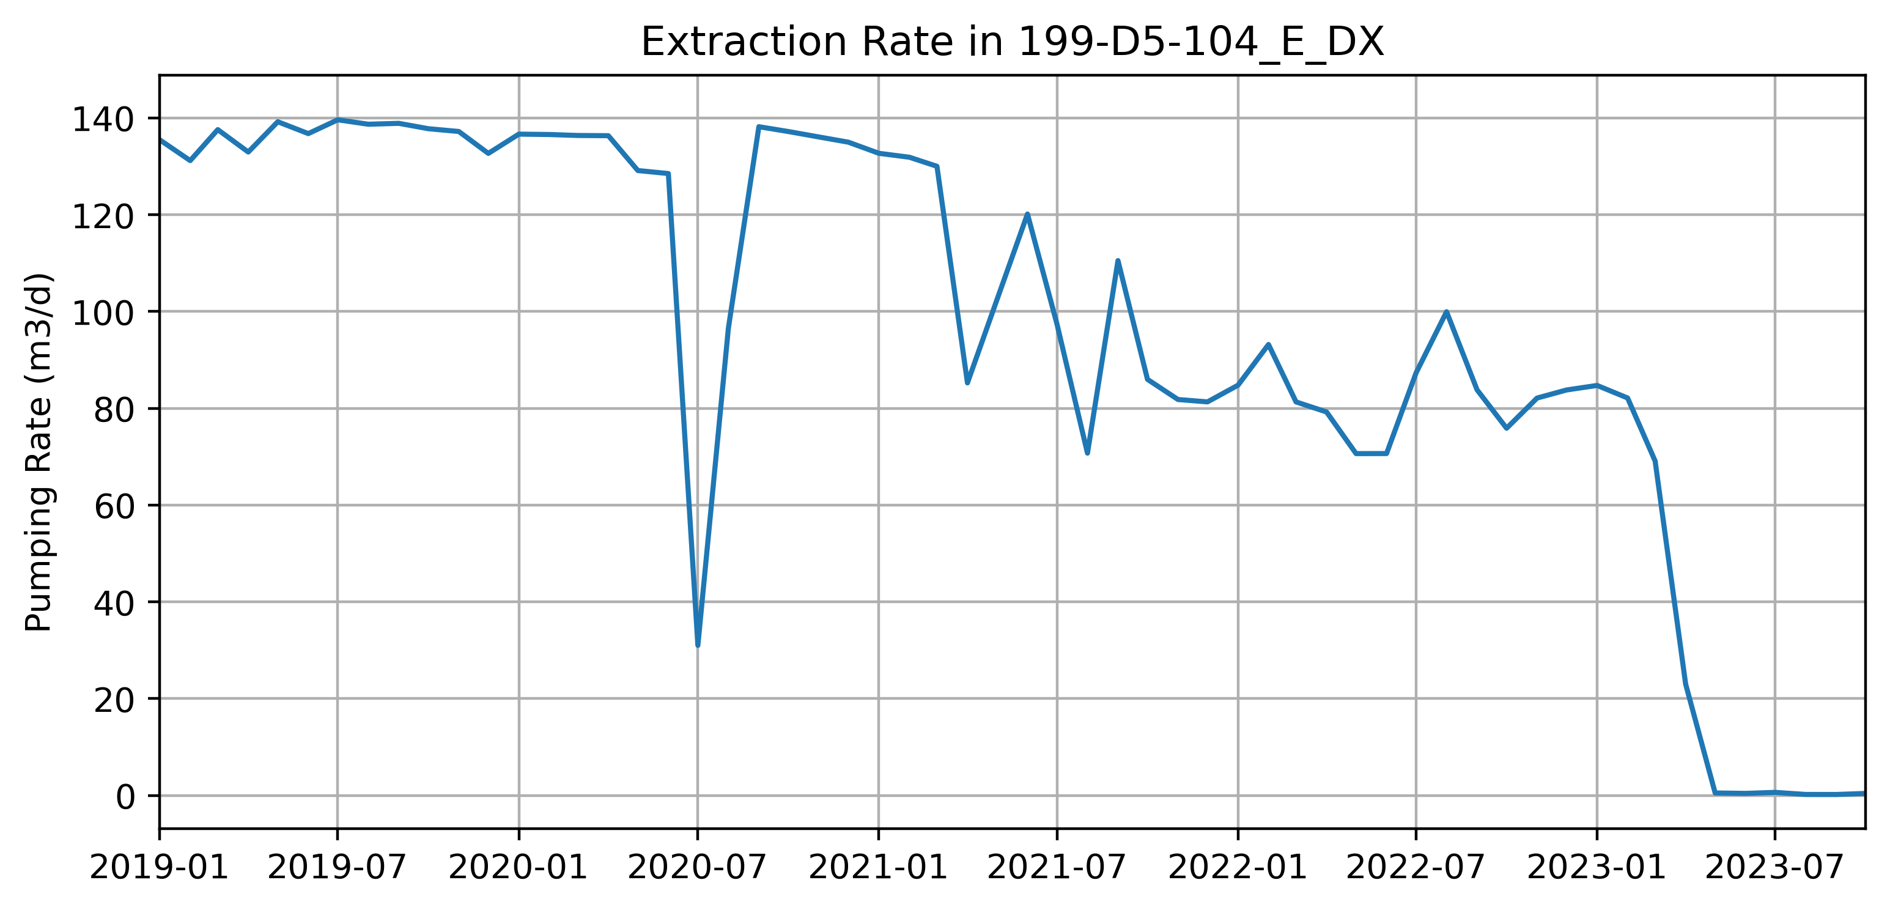
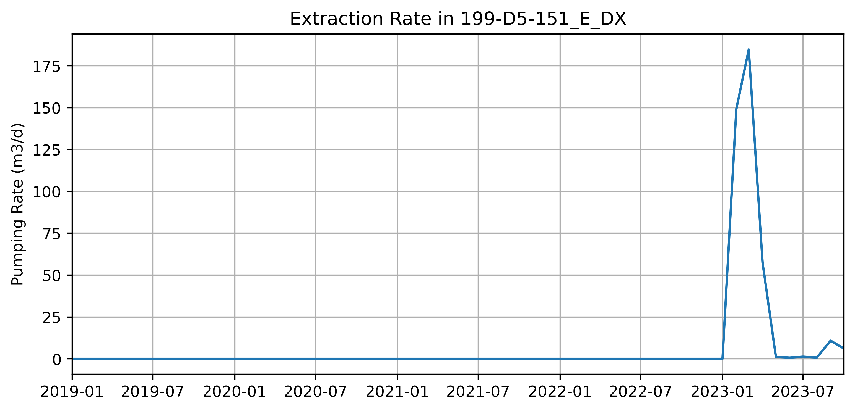
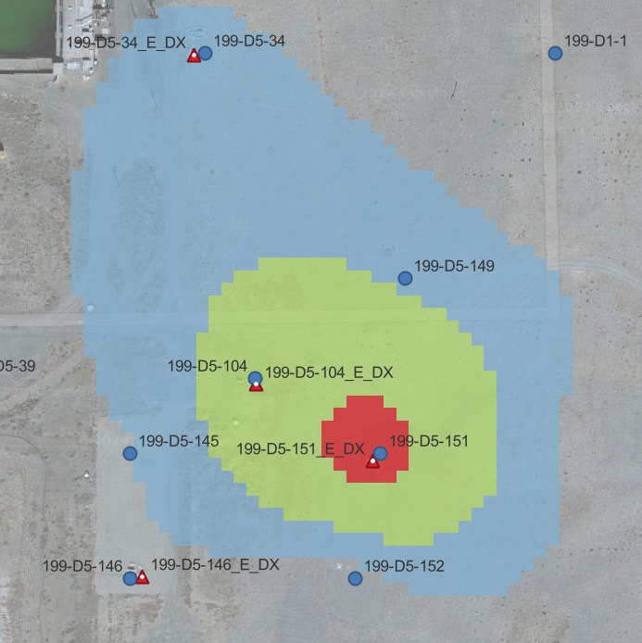
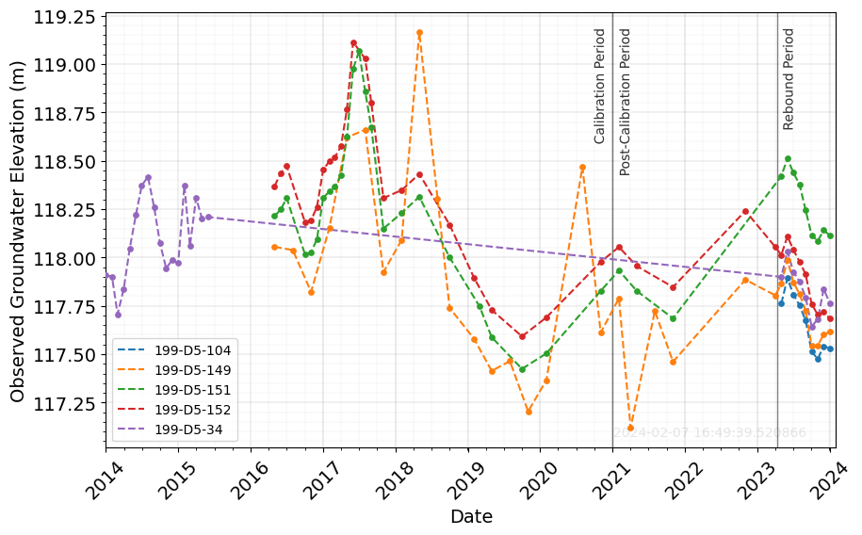
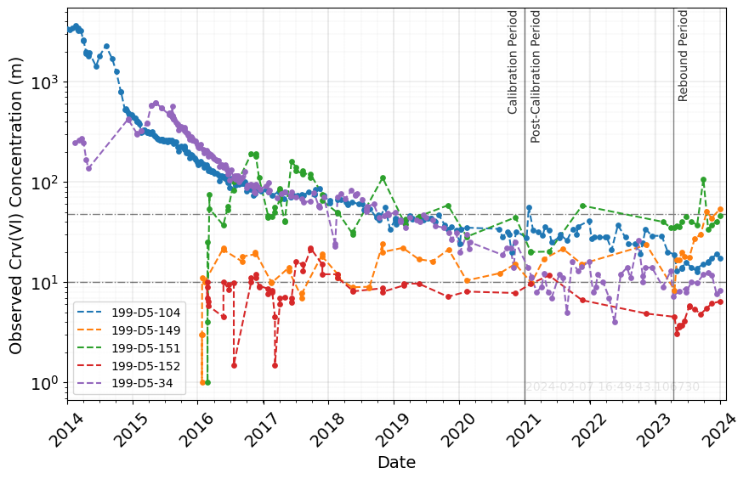
100-D-56
D5-151 pulse in SP 2/23 to 4/23
D5-34 stops in 5/23
D5-104 stops in 5/23
D5-149, D5-151, D5-152: Cr increases during rebound period, WL incr and decr during rebound
D5-104 and D5-34 stop extracting during rebound, could lead to increasing trends in mon. wells listed above?
D5-149 located N of hot spot, flow moving north? (northern ext wells outside rebound subarea still active)
D5-151: Cr spike (not increase) in middle of rebound observed (Could be due to ext D5-151 ON in SP 110 to 112)?

Slide 6
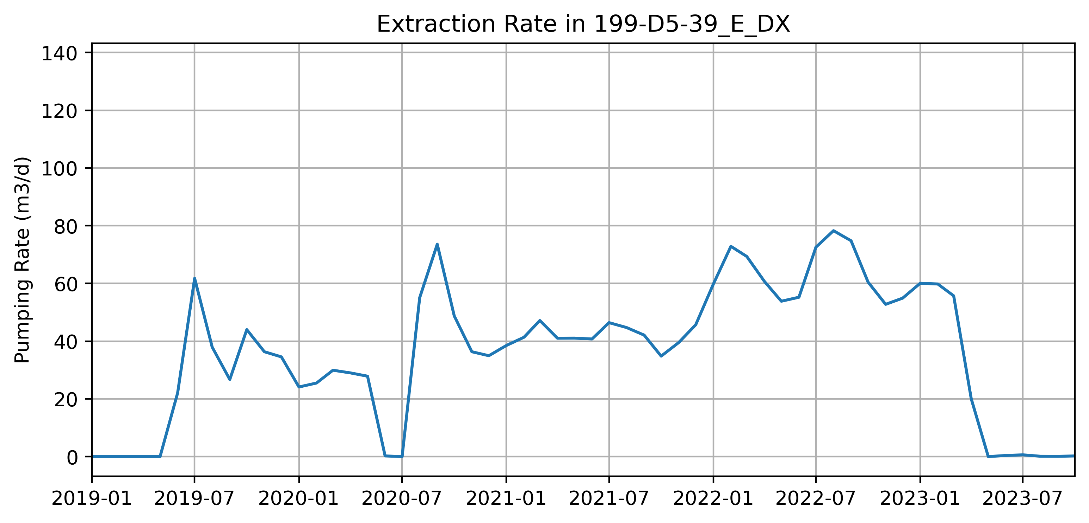
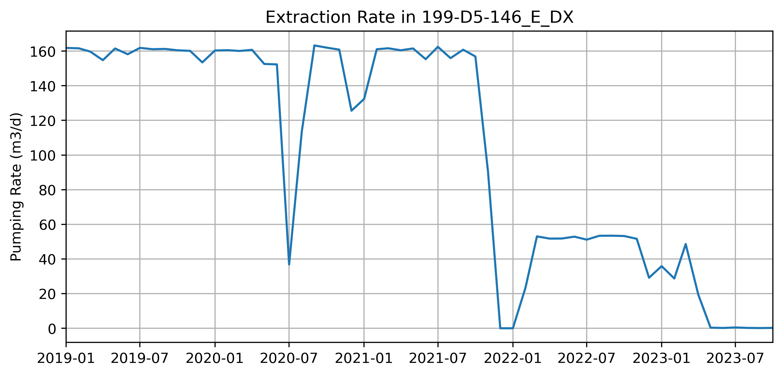
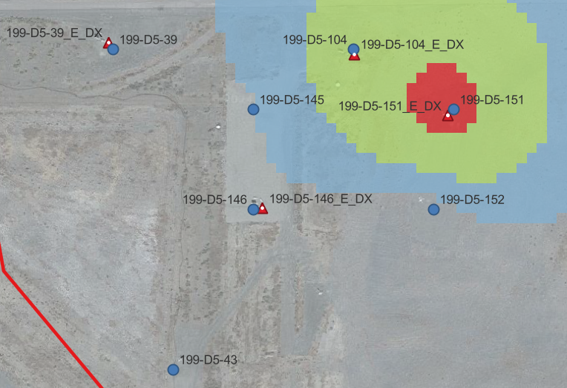
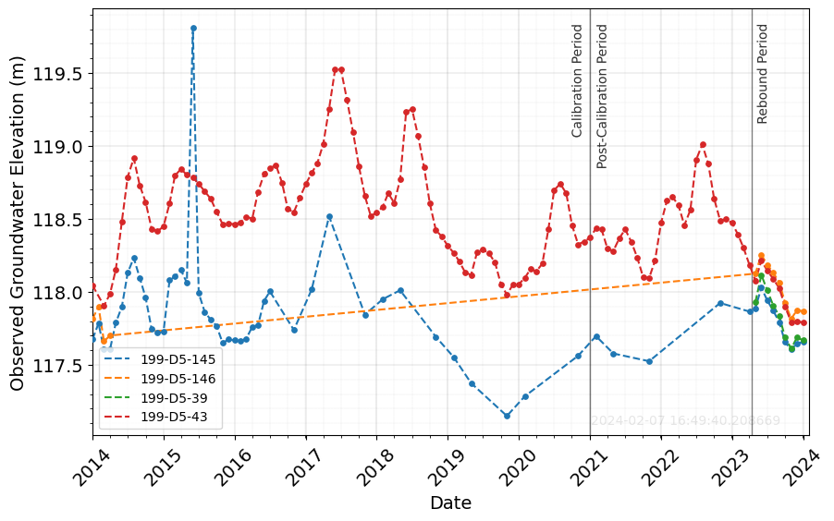
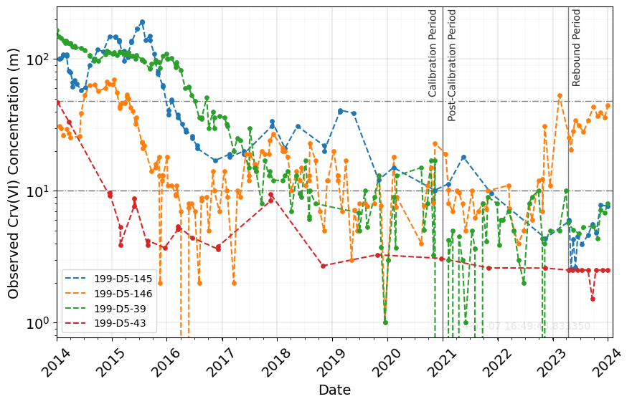
WEST OF 100-D-56
D5-39 stops in 5/23
D5-146 stops in 5/23
D5-39: Cr increases during rebound period; D5-39 stop extracting during rebound
D5-145: Cr increases during rebound period; located west of 100-D-56 source, so in migration path.
D5-146 increases even before rebound (in 2022), ext rates decreases drastically in 2022 and stops during rebound.

Slide 7
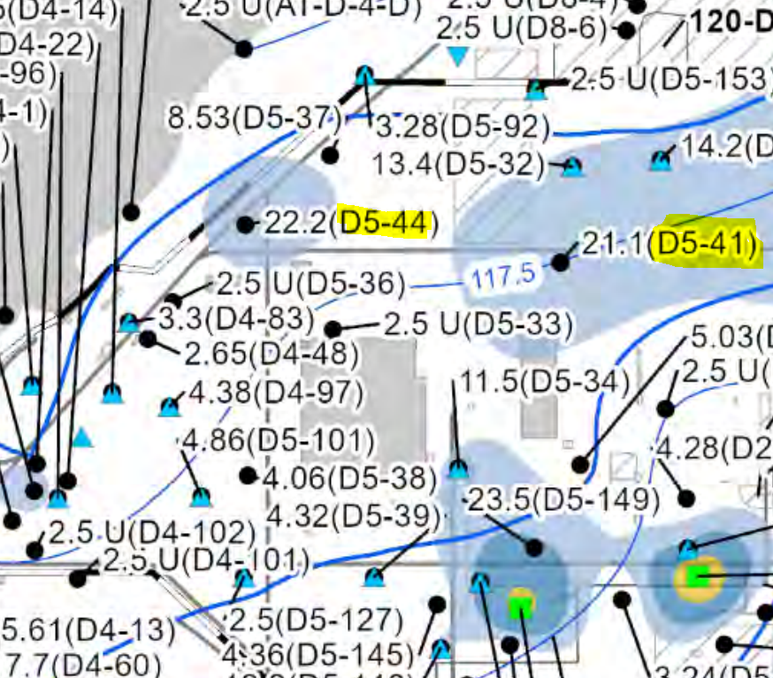
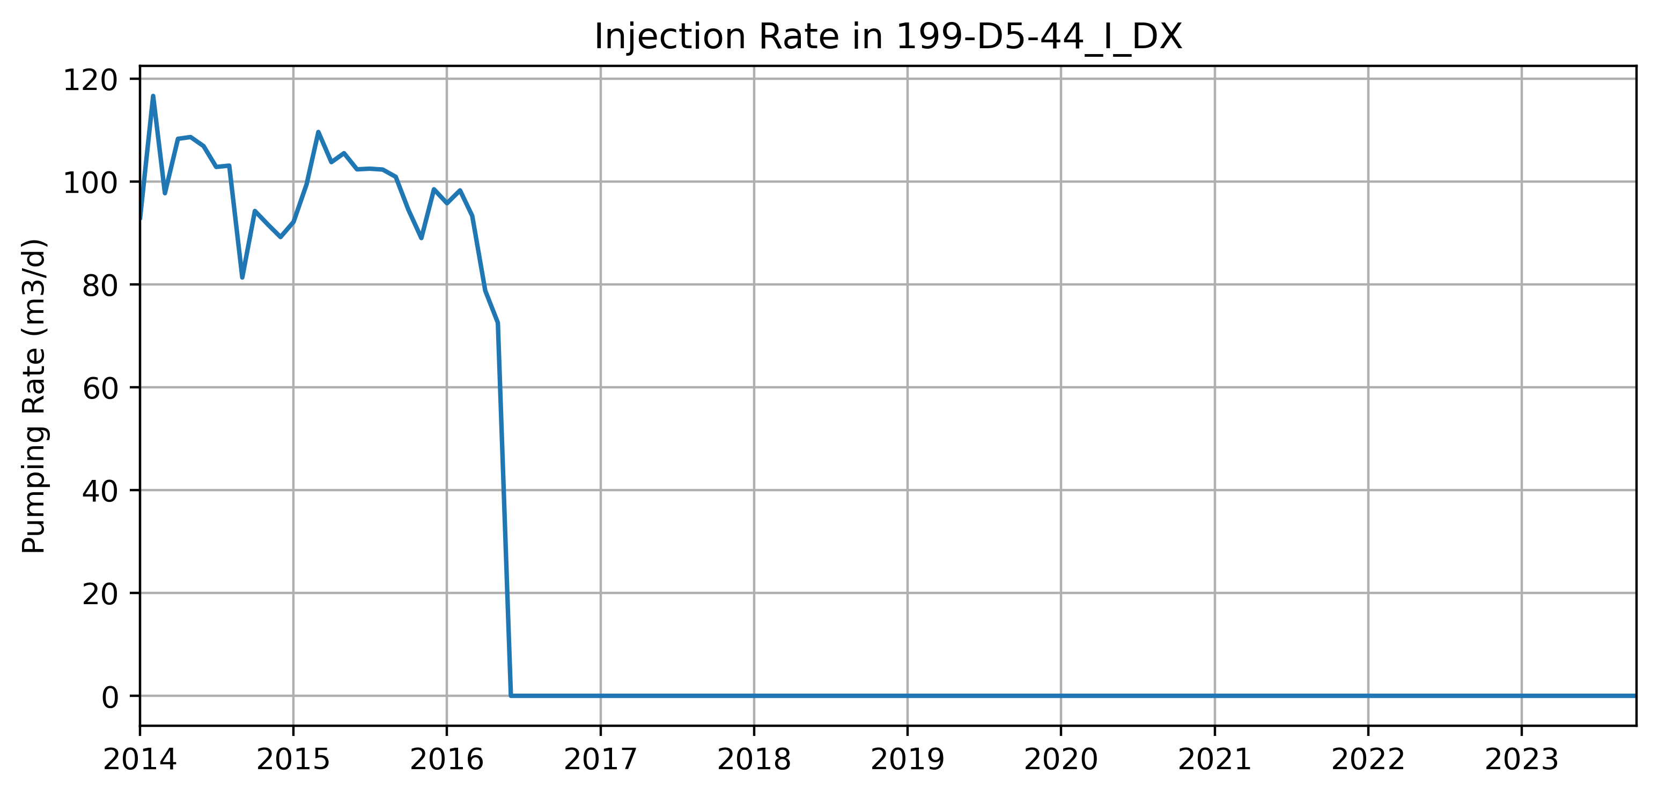
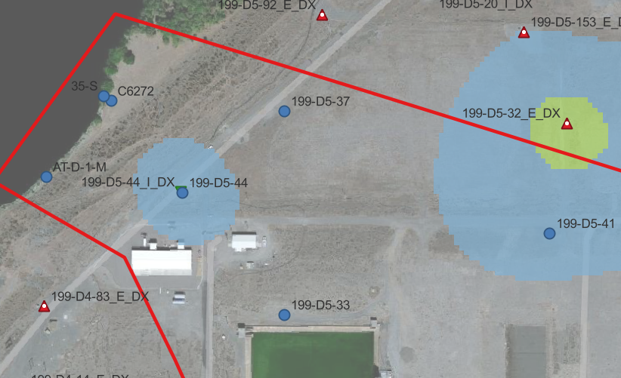
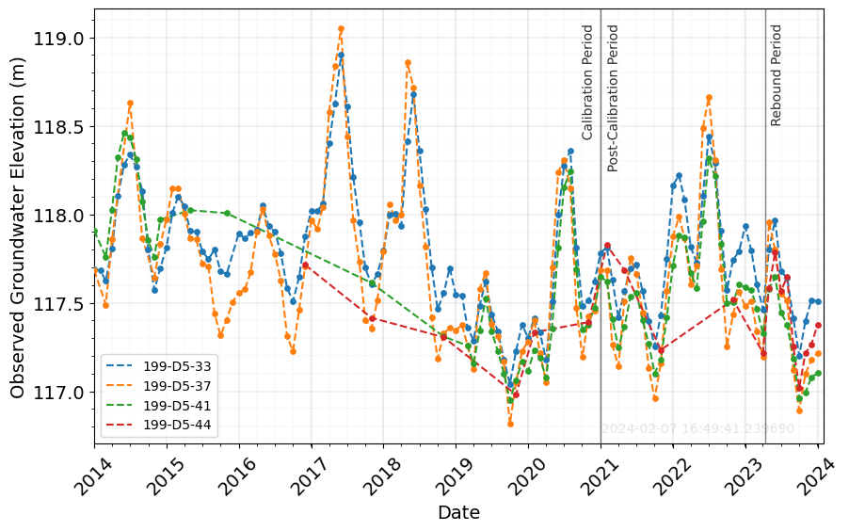
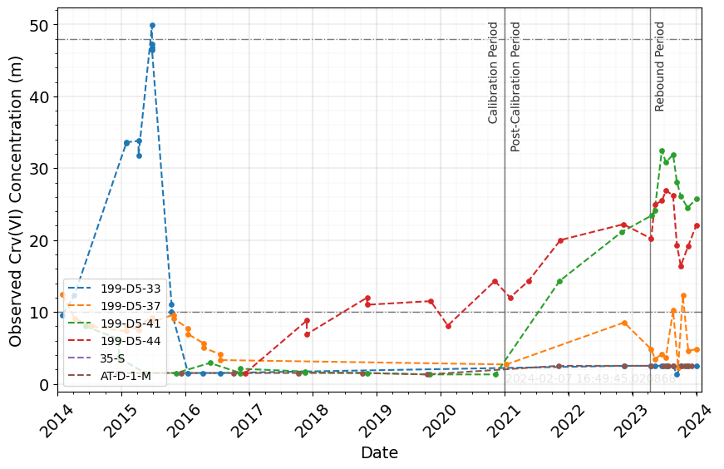
NW OF SOURCES
D5-44 stops in SP 30 (2016)
D5-41 increases even before rebound (since 2021), sitting on northern plume, and north of continuing sources (is northern plume migrating west or plume from continuing sources migrating north or both?)
D5-44 increases even before rebound (since 2017), probably because inj well at D5-44 stopped injecting in 2016 and it’s sitting on a plume and in direction path of migration of continuing sources
Wells NW of sources are < 48 ug/L, but D5-41 and D5-44 show increasing trend

Slide 8
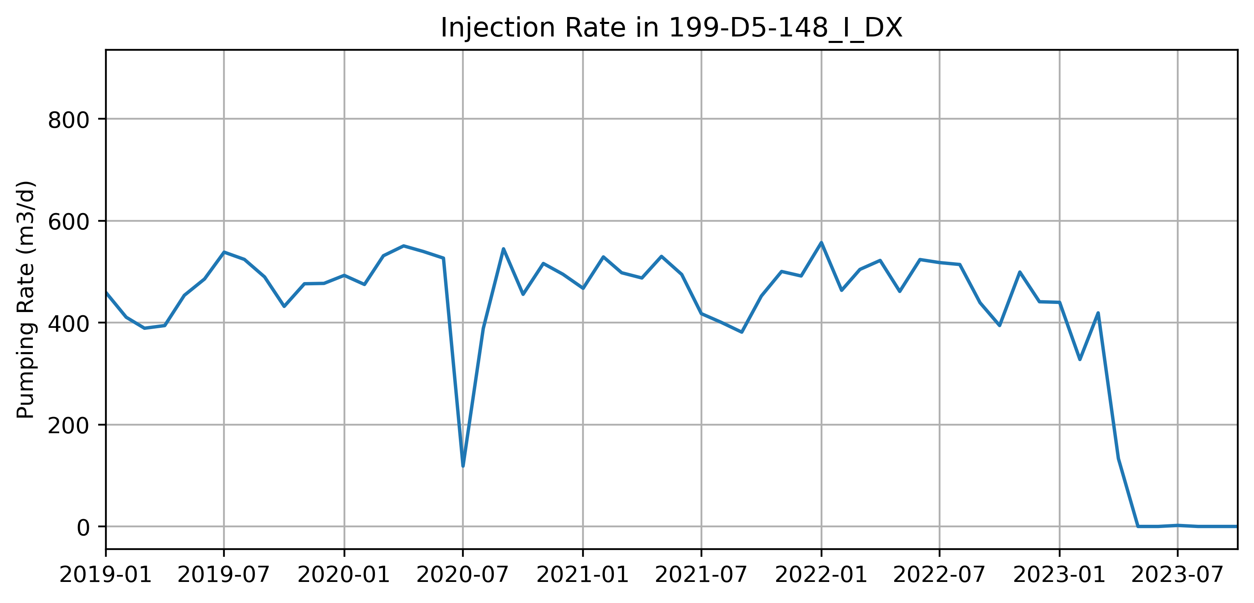
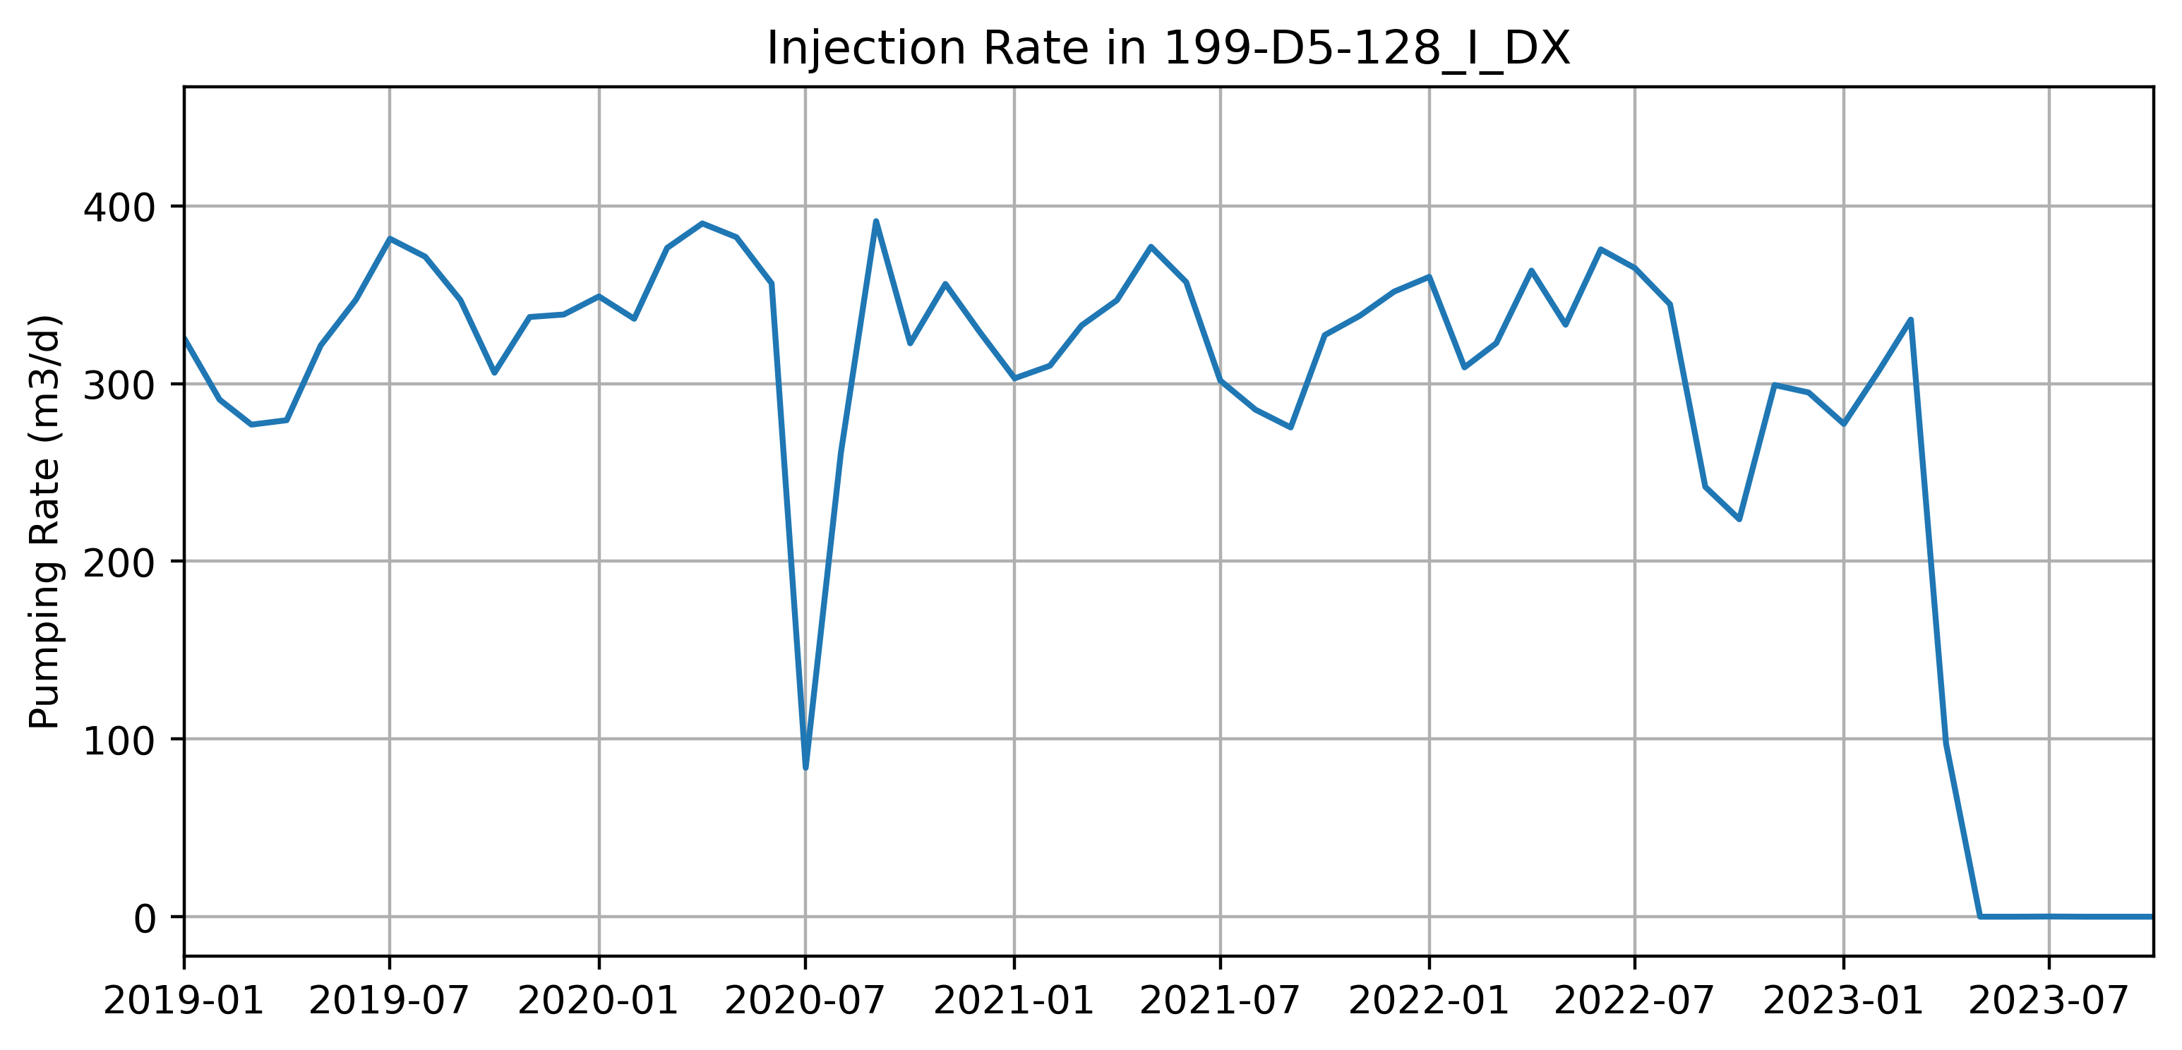
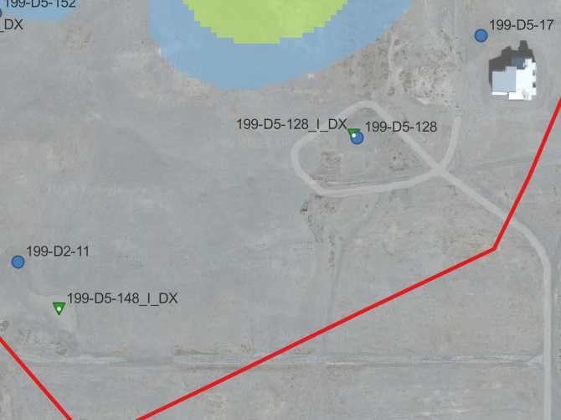
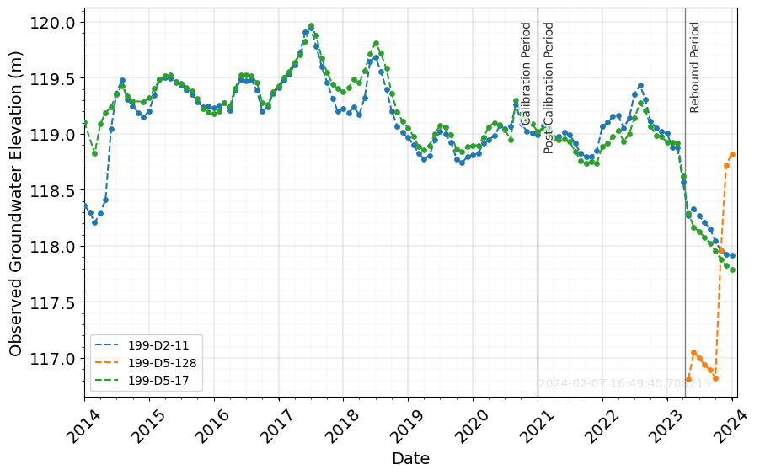
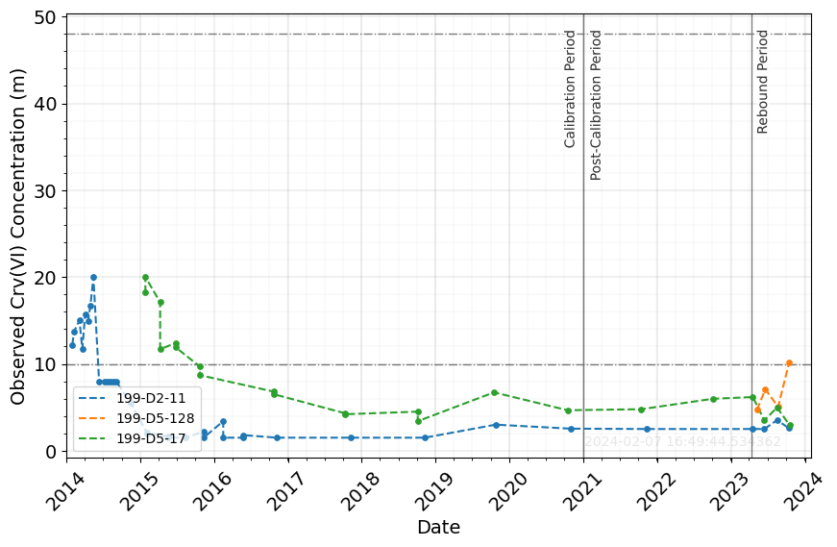
SOUTH OF SOURCES
D5-148 stops in SP 5/23
D5-128 stops in SP 5/23
D5-128 shows interesting WL behavior in rebound period. Probably due to conversion from INJ→MON
D5-128 has sparse WL and conc data to make a conclusion
Cr concentration for wells south of sources are <= 10 ug/L

Slide 9
